Slide 1


Web Development
Data Analytics & Business Intelligence Dashboard
Omji Singh
25SCS1003005314
2025 - 2029
IILM University, Greater Noida

Slide 2
Internship Overview
Bridging academic computer science foundations with industry-aligned full-stack web engineering at Codec Technologies.

Slide 3


Organization & Program Profile
Codec Technologies
Academic Context
ISO 9001:2015 certified and AICTE-recognized technology training and EdTech organisation.
Completed in partial fulfilment of the Bachelor of Technology in Computer Science and Engineering at IILM University, Greater Noida.
Specialises in structured, industry-aligned virtual internships and practical skill-building programs across modern software engineering domains.
Focused on gaining hands-on software development experience across front-end design, back-end APIs, and database engineering.

Slide 4

Problem Statement
•
Modern businesses generate vast amounts of operational and transactional data streams daily.
•
Raw unorganized data lacks actionable business utility without structured visual aggregation.
•
Traditional static spreadsheets fail to provide immediate visual insights required for executive decision-making.
•
Solution Goal: Construct a central Data Analytics & Business Intelligence Dashboard capable of importing payloads, tracking key metrics, and generating visual reports.

Slide 5









Core Project Objectives
Dynamic BI Interface
Multi-Source Pipeline
Full-Stack API Integration
Build modular, component-based React UI layouts with customizable widgets for real-time operational metric tracking.
Develop resilient data ingestion pipelines to ingest, parse, and validate JSON/file payloads into structured relational formats.
Establish RESTful API endpoints using Node.js and Express coupled with PostgreSQL for optimized schema performance and export modules.

Slide 6
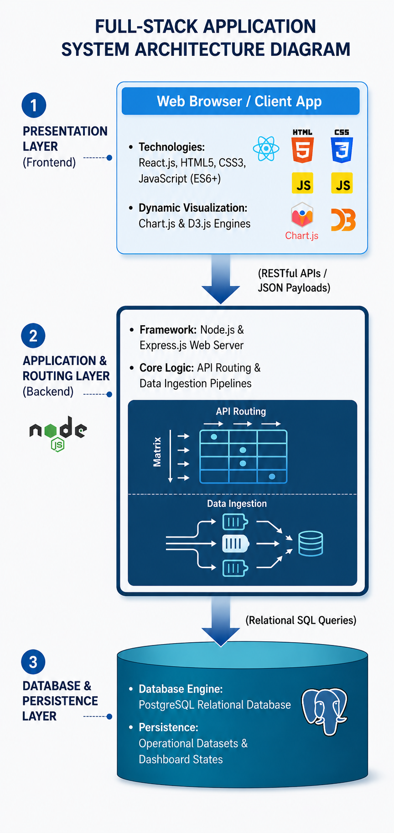
System Architecture & Stack
Multi-Tier Web Architecture
The system utilizes a 3-tier full-stack architecture dividing presentation, application logic, and data persistence for optimal performance.
Presentation Layer: React.js dynamic UI with integrated Chart.js visualization libraries for interactive metrics.
Application Layer: Express.js server on Node.js environment handling payload validation and REST route handling.
Database Layer: PostgreSQL relational database ensuring data integrity and query optimization.

Slide 7
Technology Stack Breakdown
Category | Technologies & Tools | Key Purpose in Dashboard
Frontend Layer | HTML5, CSS3, JavaScript (ES6+), React.js | Dynamic client-side UI rendering, modular components & state management
Data Visualization | Chart.js, D3.js, Bootstrap Icons | Interactive bar graphs, trend lines, proportion charts & KPI widgets
Backend API Layer | Node.js, Express.js | RESTful API routing, payload parsing, and export generation logic
Database Storage | PostgreSQL | Relational schema design, transactional persistence, and data indexing
Tools & Testing | Git, GitHub, VS Code, Postman | Version control, API endpoint testing, and code execution workflow

Slide 8




4-Week Internship Timeline
Week 4: Synthesis & Export
Week 2: React & Charts
React component hierarchy setup, state & props handling, and integration of Chart.js graphical visualizations.
Integrating client-server layers, implementing dynamic KPI filtering, analytical export engine & system evaluation.
Week 1: Fundamentals
Week 3: Node & Database
Web basics (HTML5/CSS3), ES6+ JavaScript, DOM manipulation, Git repository setup & workflow initialization.
Developing Express.js REST API routes, handling HTTP requests, and connecting PostgreSQL database schemas.

Slide 9

Key Project Achievements
End-to-End System Delivery
100%
Successfully designed, implemented, and deployed a functional Business Intelligence Dashboard platform within the 1-month intensive program timeline.
Engineered multi-source data ingestion pipelines capable of parsing payloads and generating real-time analytical summaries with zero UI lag.
Full-Stack Execution

Slide 10
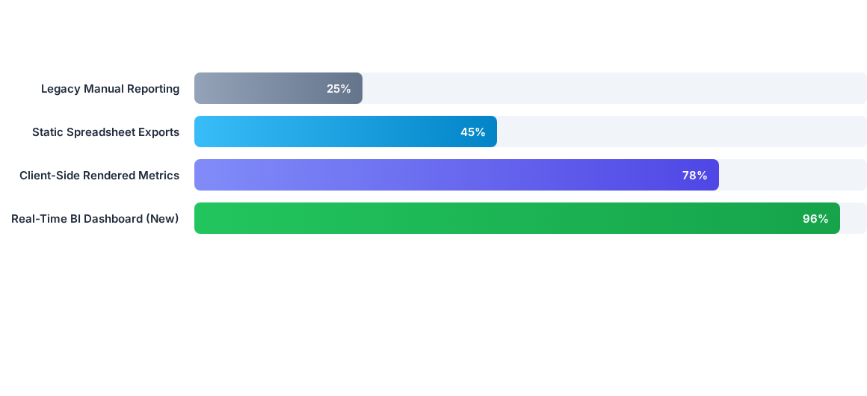
Data Processing Performance

Slide 11
THANK YOU

